Slide 1
Work with a partner to read through and answer these slides as a way to review what we have all read in Holes so far.
There will be a quiz over all of part 1 on Monday.

Slide 2
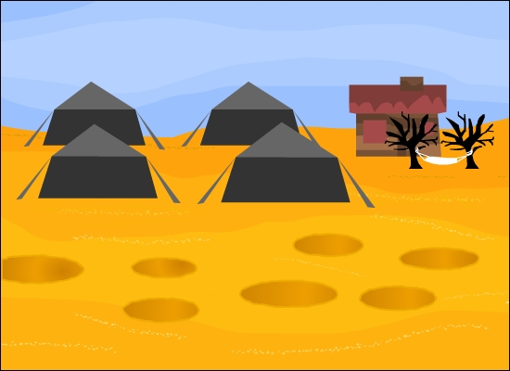

Part One
PART ONE
YOU ARE ENTERING CAMP GREEN LAKE

Slide 3



The setting
Read the first chapter of the novel.
Sachar gives his novel a very harsh setting.
How has he managed to do this?
Make a list of all the words or phrases which make Camp Green Lake sound hostile.
The word hostile means unfriendly or unwelcoming
How does Sachar create a sense of tension?
Notes:
Worksheet One accompanies this slide.
Students’ attention might be brought to the following:
The fact that there is no lake at Camp Green Lake.
The camp is a ‘dry, flat wasteland’ – The heat is unbearable and there is no shade available.
The town, lake and people who once lived there have ‘shrivelled and dried up’ which suggests that it is a dead place.
There is only one hammock, but it is reserved for a figure referred to mysteriously as ‘the Warden’.
The camp accommodates rattlesnakes and scorpions – animals dangerous to humans.
The author uses many short sentences in the first chapter, which serve to add tension to the story.
Suggested extension activity:
Students could be asked to use Sachar’s opening to help them to create their own hostile and unfriendly setting for a story.

Slide 4

Openings
Read Chapters 1 and 2 thoroughly before answering the questions below.
Why are openings important in stories?
Has Sachar managed to create an engaging opening to Holes?
Now that you know a little more about the setting, can you guess what the main themes of this novel will be?
What questions are raised in these chapters which you are interested in finding the answers to?
Notes:
The first three questions could be answered verbally as a class.
You may wish to ask students to write down their questions, in response to question 4, in the table on Worksheet Two. They can then complete the answers as they read the book. An example question is provided.

Slide 5

Stanley Yelnats – true or false?
Notes:
You may wish to ask students to complete the character card for Stanley Yelnats, on Worksheet Three, before showing this slide.

Slide 6
Camp Green Lake
Notes:
Students will need to have read as far as the second page of Chapter 7 (page 27 in the Bloomsbury edition) to complete this quiz.

Slide 7
What’s in a name?
Notes:
This quiz is best completed once students have read Chapter 5. You may like to ask students to name each character’s nickname on Worksheet Two first, and then check their answers by completing the interactive activity as a class.

Slide 8
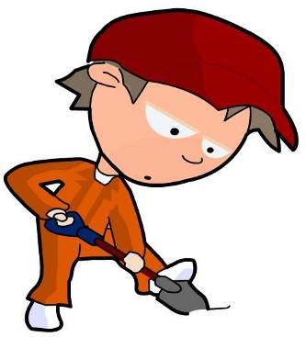
Character profiles
What do you think the characters look like?
Draw a picture of two characters from the book and label them to show why you have decided to draw them in the way you have.
Here is an example to help you think about it.
Stanley
Sunburned due to working in the heat all day
Friendly face to show he is kind
tired eyes

Slide 9
The sub-plot
A sub-plot is the part of a story which is told alongside the main plot, but is different from it in some way. Often the significance of a sub-plot is not revealed until the end of a story. In Holes, there is a sub-plot which runs parallel to the main plot set at Camp Green Lake.
What is the sub-plot of Holes? Who are the main characters of this sub-plot and how are they related to the main storyline? Write down your ideas.
love
Madame Zeroni
America
pig
stream
Notes:
Click to give students a few clues.
Direct students to Chapter 7. The sub-plot is the story of Madame Zeroni and Stanley’s great-great-grandfather, Elya Yelnats who is in love with a brainless girl called Myra. You may wish to ask students to write their own summary of the sub-plot so far using the words shown.
Worksheet Four accompanies this slide, and includes extension questions.

Slide 10
Stanley’s pig-stealing-great-great-grandfather!

Slide 11

Stanley’s diary
Read Chapters 7–9, which describe Stanley’s first full day at the camp.
Can you explain Stanley’s letter to his mother? Why does he lie to her?
Imagine that as well as writing home to his mother, Stanley also keeps a diary in which he is completely truthful about his life at the camp. How would it differ to his letters home?
Write an honest diary entry for Stanley’s first full day at Camp Green Lake.
Notes:
Worksheet Five accompanies this slide.
This diary entry could be the first in a series which students are asked to write providing an ongoing summary of the novel. This would allow you to assess the extent to which students know the text and understand the characters’ situation and emotions.

Slide 12
Comprehension
Read Chapters 10 and 11 and then complete the questions below, using full sentences and giving reasons for your answers wherever possible.
Chapter 10
How can you tell that Stanley is tired?
Why does Stanley show the fossil to Mr Pendanski?
How can you tell that Mr Pendanski is not interested in the fossil?
Chapter 11
Why does Stanley agree to give anything he finds in the future to X-Ray?
What prompts Stanley to think of Derrick Dunne?
How does he feel about Derrick Dunne?
Notes:
Worksheet Six accompanies this slide.
These questions require more than a factual knowledge of the text, required by the quizzes. Students should be encouraged to write extended answers which show understanding and which are supported by evidence from the text.

Slide 13

Predictions
Can you guess why this object might be more ‘interesting’ to the Warden than the fossil which Stanley also found?
What do you think the tube is?

Slide 14
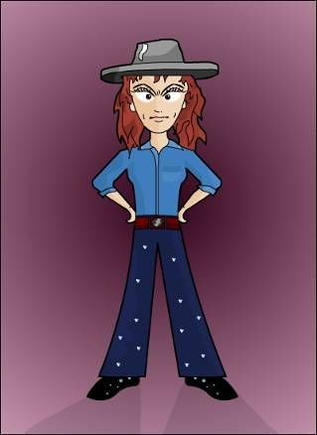
The Warden
In Chapter 14, we meet the Warden.
Read the description of the Warden from ‘A tall woman…’ until ‘Her voice was soft’.
This description does not say the warden is a bad person. However, how has Sachar hinted at a darker, or more sinister side to her?
Notes:
This description appears on page 66 of the Bloomsbury edition of the novel.
Possible ideas in response to question:
The Warden is responsible for the boys at Camp Green Lake and therefore responsible for their hot days digging holes.
The Warden is unafraid to walk straight up to X-Ray (the toughest boy in the group) even though she does not know him.
The Warden is amazed by Mr Pendanski’s question and does not seem to like it because she stares ‘hard at him’. The softness of her voice is not intended to sound friendly but to be quietly threatening and frightening.
Finally (and arguably), the Warden is a woman, when the reader may well have been expecting a man. It could be suggested that it takes a strong or harsh woman to be responsible for such a tough camp which is run for boys only. Her clothes are cowboy-like and therefore quite masculine.
Extension question:
In what way does the remainder of Chapter 14 convince you that the Warden has a sinister side to her personality?

Slide 15

Complete the Warden’s identity badge:
Name:
Age:
Occupation:
Duties and responsibilities:
______________
______
____________________________
______________________________ __________________________________________________________________________________________
______________________________
______________________________
Notes:
You may like to ask students to complete their own identity badge for the Warden on Worksheet Seven, before feeding back to the class.
Some of the details will have to be invented – the purpose of the task is to get students thinking about the roles of the adults at the camp. It will also require students to have carefully read the description of the Warden.

Slide 16
Teamwork

Slide 17
Reading and writing
In Chapter 18, Zero asks Stanley to teach him to read but Stanley refuses. Stanley seems to be quite kind, so why doesn’t he want to help Zero?
What kinds of things do people who cannot read or write miss out on?
Why is it important to learn how to do these things?

Slide 18
Zero
Notes:
You may wish to ask students to complete the character card for Zero, on Worksheet Seven, before completing this activity.

Slide 19
Kissin’ Kate Barlow

Slide 20
Sam and Kate’s relationship

Slide 21

Kissin’ Kate Barlow – comprehension
The love story between Katherine and Sam is important in the novel. Can you guess why?
When do Sam and Katherine fall in love and how do they manage to see each other regularly?
Why do the people of Green Lake disapprove of the relationship between Sam and Kate?
What do they do as a consequence of their hate?
Who is the main instigator of the trouble?
Can you work out why Camp Green Lake becomes dry and barren?
Notes:
These questions relate to Chapters 23, 25, 26 and 28. Worksheet Eight accompanies this slide.

