Slide 1
Work through the slides to review what we have read of Part 2 so far.
Some of the questions require answers to be written out on your worksheet. Follow along as you go.

Slide 2
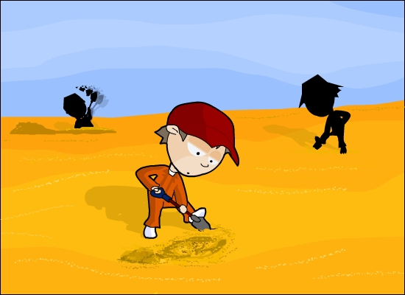
Part Two
PART TWO
THE LAST HOLE

Slide 3
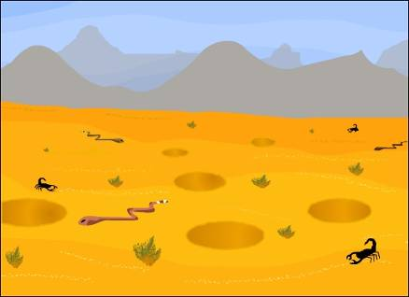
Atmosphere
Read the first page of Part 2 until ‘a barren wasteland’.
What atmosphere is created by Sachar at the start of Part 2?
How can you tell that something important is about to happen? What do you think it is?
Notes:
Part 2 begins on page 127 of the Bloomsbury edition of the novel.
The fact that there is a change in the weather is significant because the weather has been consistent up until this point. The bad weather seems to be a warning to the boys at the camp that something important, and possibly bad, is about to happen because it does not only change, but changes ‘for the worse’. These words get their own line in the text which gives them weight.
Teachers may wish to discuss the relevance of weather in Shakespeare plays (such as Macbeth) or even in the Bible where poor weather is often a communication or punishment from God.

Slide 4
Zero, Zigzag and X-Ray
Notes:
Students will need to have read to the end of Chapter 30 to complete this activity. Worksheet Nine accompanies this slide. Students could be asked to complete Worksheet Nine with as much information as they know about the three characters. This interactive activity could then be completed as a class, with students then volunteering any additional information they have noted about the characters.

Slide 5
Conflict – comprehension
In Chapter 30, Stanley and Zigzag fight.
How does the argument start between Stanley and Zigzag?
Why does Mr Pendanski encourage the fight?
How can you tell that Zero and Stanley have developed a bond?
How does the Warden try to humiliate Zero?
Why do you think Zero runs away?
Why do none of the adults try to stop Zero from escaping?
Notes:
Worksheet Ten accompanies this slide.

Slide 6
Stanley’s diary
When Zero runs away, Stanley is left alone and another boy, Twitch, arrives in Zero’s place. Finally, Stanley decides to leave too.
Imagine that you are Stanley. Write a diary entry in which you are completely truthful about what has happened at camp and why you decided to run away.
Think especially about how Stanley would feel about the Warden’s attitude to Zero’s disappearance. Remember to mention any fears he might have as well.
Notes:
Worksheet Eleven accompanies this slide.
Students should have read up to and including Chapter 33 in order to complete this task. It may be useful to run through conventions of diary writing for less able students.
Remind the students that the Warden’s solution is to destroy all Zero’s records and pretend that he never existed.

Slide 7
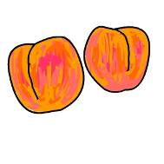
Sploosh!
A food company has decided to produce bottles of Sploosh! Imagine that you are part of the marketing team.
Spoolsh
Your task is to design the label for the bottle of Sploosh to encourage shoppers to buy it. Think carefully about the words and pictures on the label.
Notes:
Students should have read up to and including Chapter 35 in order to complete this task.
N.B.: Students are being asked to create a label for Sploosh which is a peach-based food here, not an odour eater product, as is advertised by the character Clyde Livingstone in Chapter 50.
You may wish to ask students to create their design within the box on Worksheet Twelve. You can then cut these out, paste them around old glass containers and display them.
You may also like to show students examples of fruity products’ packaging before discussing persuasive techniques used on packaging.

Slide 8
I’m an English student…Get me out of here!

Slide 9
Treasure maps
Draw a detailed treasure map of Camp Green Lake and the surrounding area.
X
Once you have done this, write down an important thing that happens at each location.
Notes:
Worksheet Thirteen accompanies this slide.
This exercise tests students’ knowledge of the text and their ability to understand the significance of places in the novel.
Locations students may mark on their maps include:
The big thumb, where Zero and Stanley go for safety
X, where the treasure is buried
Holes, where the boys have worked
The Warden’s hut, where the Warden scratched Mr Sir on the face.
Differentiation is by outcome – only the most able students will be able to fully complete the second part of the task.

